Slide 1
Status of the Hybrid Doppler Wind Lidar Transceiver ACT project
Cathy Marx, Bruce Gentry, Patrick Jordan (NASA/GSFC)
Michael Kavaya (NASA/LaRC)
Ed Faust (SGT)
Pete Dogoda (SigmaSpace)
May 2012

Slide 2
Objectives and Challenges
Build compact, light weight, four field of view transceiver including reliable field of view mechanism. Operational at 2 µm and 355 nm.
Test subsystem performance at 2 µm
Integrate with 355 nm laser and receiver to verify performance on the ground.
Challenges:
  Requires high throughput at 355 nm and 2 µm
  Common transmit and receive path
    Requires coatings which can withstand high energy densities over long lifetime.
  Select mechanism
    Precise location for four positions
    Runs repeatedly over 9 million cycles for the space program
  Build to aircraft requirements.
Demonstrate path forward to technology challenges for space based 3D Wind mission.

Slide 3
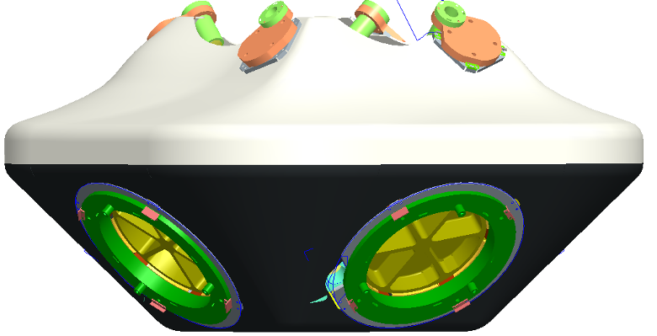
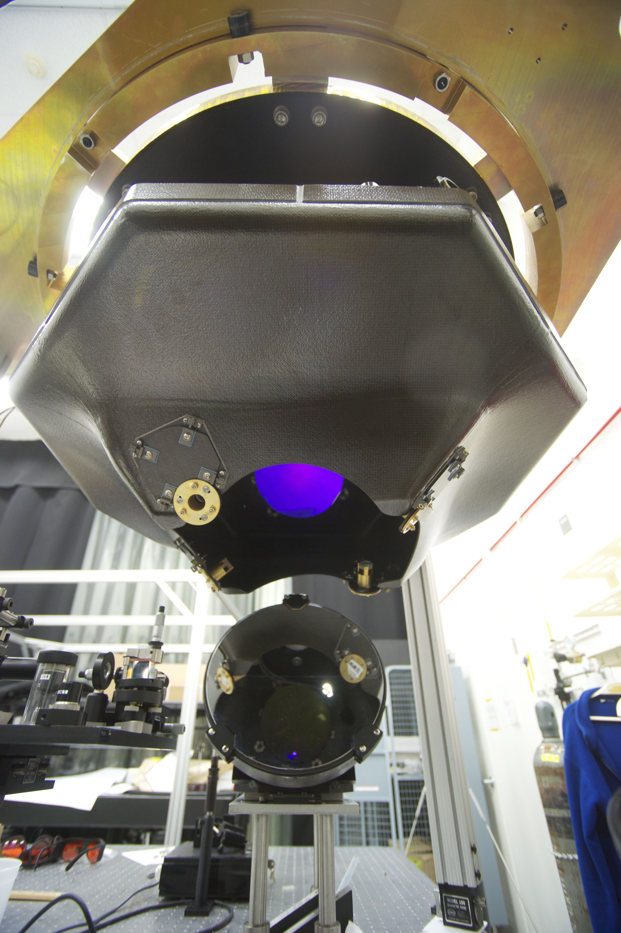
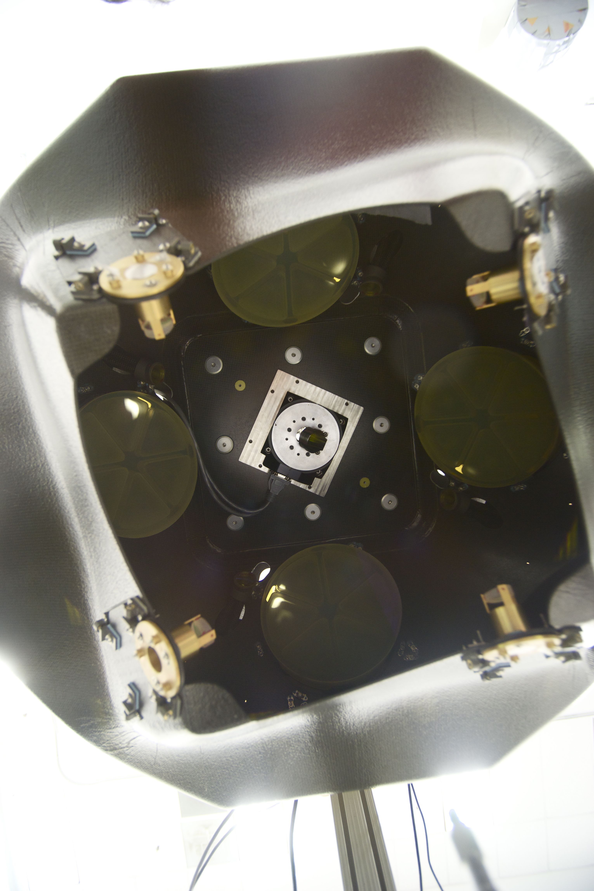
Hybrid Doppler Wind Lidar (HDWL) Transceiver
PI: Cathy Marx, NASA GSFC
Build a compact, light weight, 4 field-of-view (FOV) transceiver, including a reliable FOV select mechanism, in support of the Global Tropospheric 3-D Winds mission
Test subsystem performance with 2 μm source
Integrate the hybrid transceiver with ground based 355nm lasers and receivers
3-D model and pictures of the 4 FOV HDWL transceiver
Use compact mechanical packaging to achieve a 4-FOV hybrid transceiver
Use precision, light-weight, thermally stable composite structure
Design for efficient operation in the UV and IR
Design long life mechanisms to select operational FOV
Test optical performance at 2 μm in the lab
Conduct ground based tests by integrating HDWL with the Goddard Lidar Observatory for Winds (GLOW)
Leverage prior NASA investments in coherent and direct detection lidar instrument technologies
Define instrument requirements and interfaces 07/09
for the 355nm and 2µm systems
Complete telescope optical design 12/09
Complete mechanical design of select mechanism 02/10
Complete assembly and performance testing of 03/11
the FOV select mechanism
Assemble telescope 02/12
Assemble transceiver and perform subsystem 04/12
level testing at 355 nm and 2 μm
Integrate transceiver with 355nm laser and 05/12
receiver
Co-Is/Partners: Bruce Gentry, Patrick Jordan, NASA GSFC; Michael Kavaya, NASA LaRC
TRL_{in} = 2 TRL_{current} = 2
ACT-08-0026

Slide 4
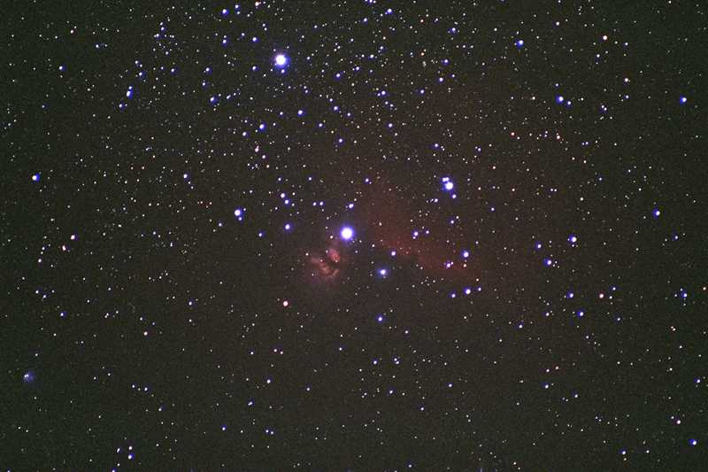

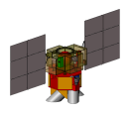
Hybrid Doppler Wind Lidar Measurement Geometry: 400 km
Return light: t+3.9 ms, 30 m, 4.4 microrad
Second shot: t+200/10 ms
1535/77 m, 227/11 microrad
First Aft Shot
t + 190 s
7.7 km/s
90° fore/aft angle
in horiz. plane
45°
RIGHT, FORE
585 km
RIGHT, AFT
Ground spot speed: 7.2 km/s
400 km
45 deg azimuth Doppler shift
from S/C velocity
±3.7 GHz
±22 GHz
Max nadir angle to
strike earth
70.2 deg
5 m (86%)
180 ns (27 m) FWHM (76%)
45°
2 lines LOS wind profiles
1 line “horizontal” wind profile
414 km
48.7°
60/1200 shots = 12 s = 87 km
292 km
0.2/0.01 s = 1444/72 m
(2/0.355 microns)
292 km

Slide 5

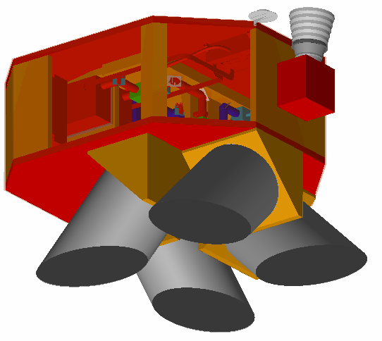
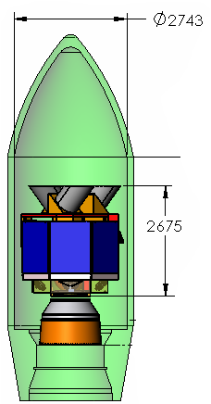
GWOS IDL Instrument
Star Tracker
Hybrid DWL Technology Solution
GPS
Nadir
Telescope Modules (4)
GWOS Payload Data
GWOS in Delta 2320-10 Fairing
Dimensions | 1.5m x 2m x 1.8m
Mass | 567 Kg
Power | 1,500 W
Data Rate | 4 Mbps
Dimensions (mm)
Orbit: 400 km, circ, sun-sync, 6am – 6pm
Selectively Redundant Design
+/- 16 arcsec pointing knowledge (post-processed)
X-band data downlink (150 Mbps); S-band TT&C
Total Daily Data Volume 517 Gbits

Slide 6
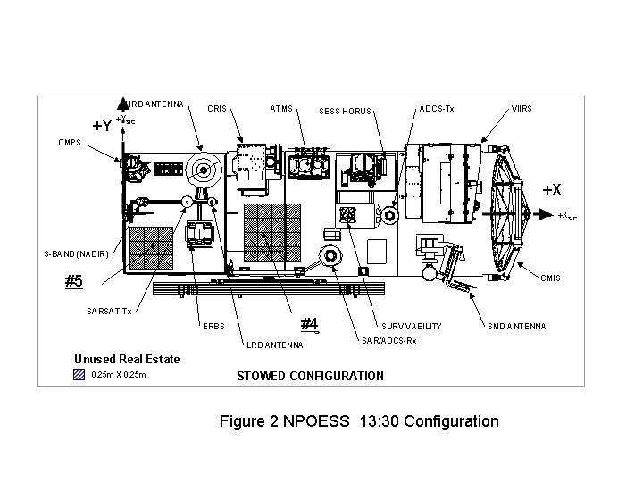
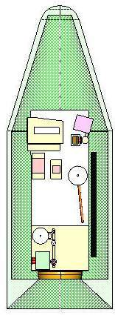
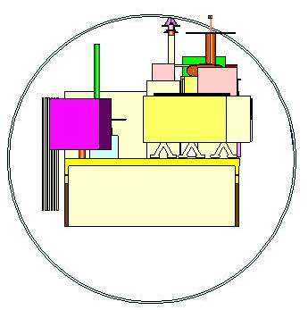
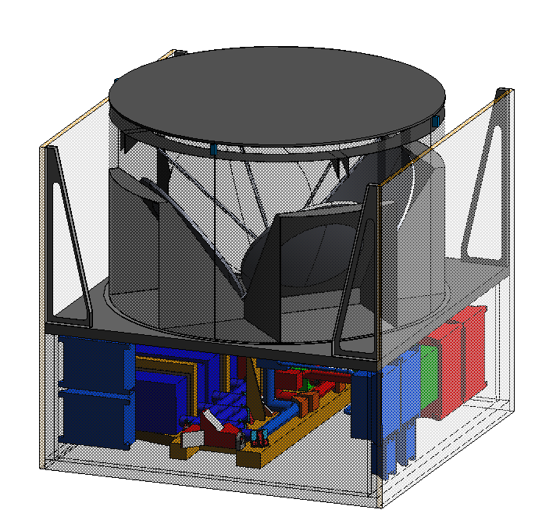
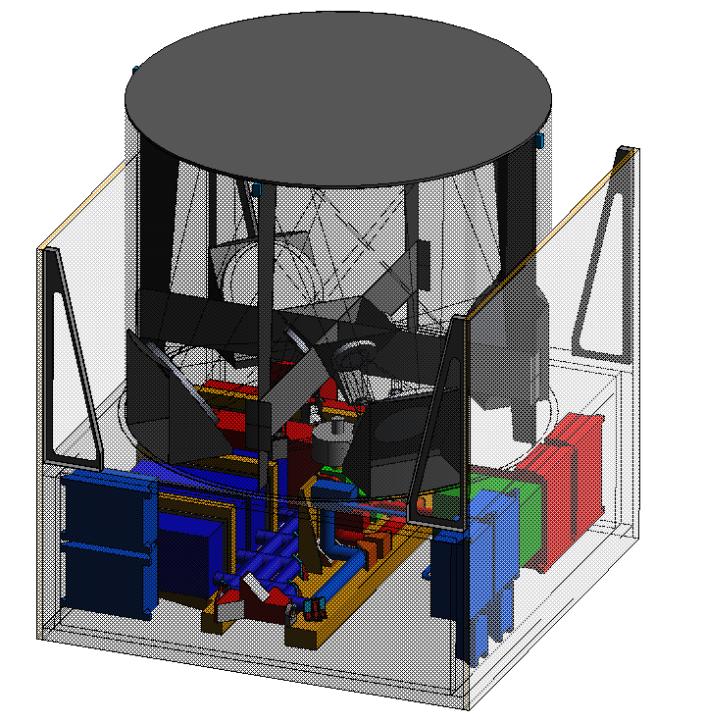
Preliminary Instrument Design Results
NexGen Hybrid Doppler Wind Lidar - NWOS
NPOESS Wind Observing System For Vertical Wind Profiles
I n t e g r a t e d D e s i g n C a p a b i l i t y / I n s t r u m e n t D e s i g n L a b o r a t o r y
Launch Concept for the Atlas 5 - 4 m Diameter Fairing
NPOESS 1730 LAN Spacecraft
NPOESS LAN 1730 S/C Sensor Configuration
4.5 m
5.7 m
3.75 m dia.
= Space Considered for NWOS
NWOS HDWL Instrument Trade Summary
NWOS HDWL Instrument Configurations
 | Configuration #1 | Configuration #2 | Configuration #3
Optical Design | Shared, Inverted GWOS,4 azimuths 100 % Duty Cycle | Shared, Inverted GWOS,4azimuths 50 % Duty Cycle | Common Aperture, ShADOE,4 azimuths 100 % Duty Cycle
Mass [kg] | 595 | 595 | 661
Telescope Module Dimensions (ht x dia) | 100x160cm | 100x160cm | 127x160
Structural Assem. Dimensions | 72.5 x 170 x 170cm
Telescope Primary Diameter | 0.7m (0.5m Coherent) | 0.7m (0.5m Coherent) |  | 1.24m (0.72m Coherent)
Orbital Avg Power [W] | 1382 | 898 |  | 1382
Peak Power [W] | 1382 | 1382 |  | 1382
Standby Power [W] |  | 719
Warmup Power [W] |  | 861
Configuration 1 and 2
(Inverted GWOS)
Configuration 3
(ShADOE)
No contingency added (+30%)

Slide 7
Requirements
 | ACT |  | ACT |  | Space Demo |  | Space Demo
 | 355 nm |  | 2 um |  | 355 nm |  | 2 um
Platform Altitude* | 12 to 20 km |  | 12 to 20 km |  | 400 km |  | 400 km
Telescope collecting aperture | 8" (0.2 m) |  | 8" (0.2 m) |  | 0.5 m |  | 0.5 m
Number of look angles | 4 |  | 4 |  | 4 |  | 4
Telescope view angle | 45 deg above horizon, equally spaced in azimuth |  | 45 deg above horizon, equally spaced in azimuth |  | 45 deg above horizon, equally spaced in azimuth |  | 45 deg above horizon, equally spaced in azimuth
Telescope magnification | 10 |  | 10 |  | TBD |  | TBD
Telescope configuration | -- |  | unobscured telescope |  | -- |  | unobscured telescope
Throughput requirements | >90% |  | >90% |  | >90% |  | >90%
Telescope image quality | 95% in 100 urad blur (TBR) |  | diffraction limited at 2-um |  | 95% in 100 urad blur (TBR) |  | diffraction limited at 2-um
Field of view | 100 urad |  | Diffraction limited
* NASA research aircraft, e.g. DC8 and WB57, are target platforms for design. ACT demonstration will be on ground.

Slide 8
Simplified Schematic Final Setup
1 of 4
Telescopes
DAWN Laser/Receiver
Quarter Wave
Circular Polarizer
Dichroic B/S
Polarizing BS
Telescope Select
Mechanism
GLOW Laser
Half Wave Plate
Quarter Wave
Circular Polarizer
Fiber coupler
ACT Components
Multi-Mode
Optical Fiber
GLOW
Receiver
Path Key:
Coherent beam
Direct beam
Transmit Components
Fiber

Slide 9
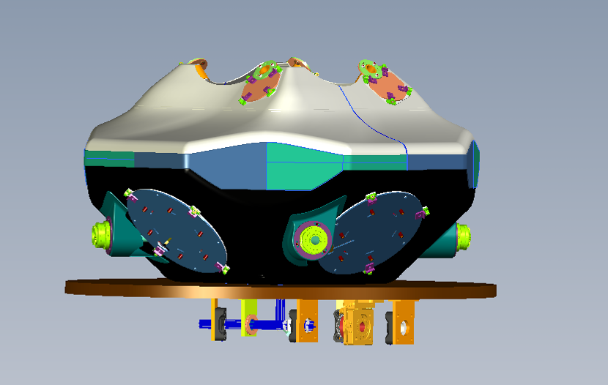
Baseline Design
Secondary Mirror Mounts
Structure
Fold Mirrors
Primary Mirror Mounts
Optic Bench
(2) Laser/Receiver
(355) laser input

Slide 10
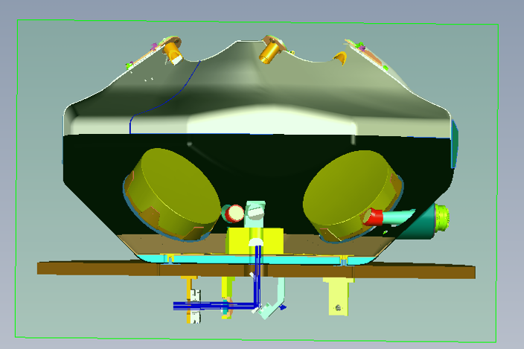
Ray-Trace/Structure Design
Out
Secondary mirror
Primary
FOV Select
Mechanism
Folding mirror
Indexing mirror
Optics to Lasers/Receivers

Slide 11
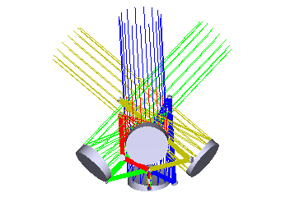
Telescope Design
Outgoing laser
Incoming return
Key parameters
  4 identical telescopes
  Demagnification of 11.1
  Afocal system
  Primary and secondary are both off-axis parabolas
Telescope spacing influenced by compatibility with aircraft version where a window is needed.
Primary
Secondary
4 Primaries
Top View
Side View

Slide 12
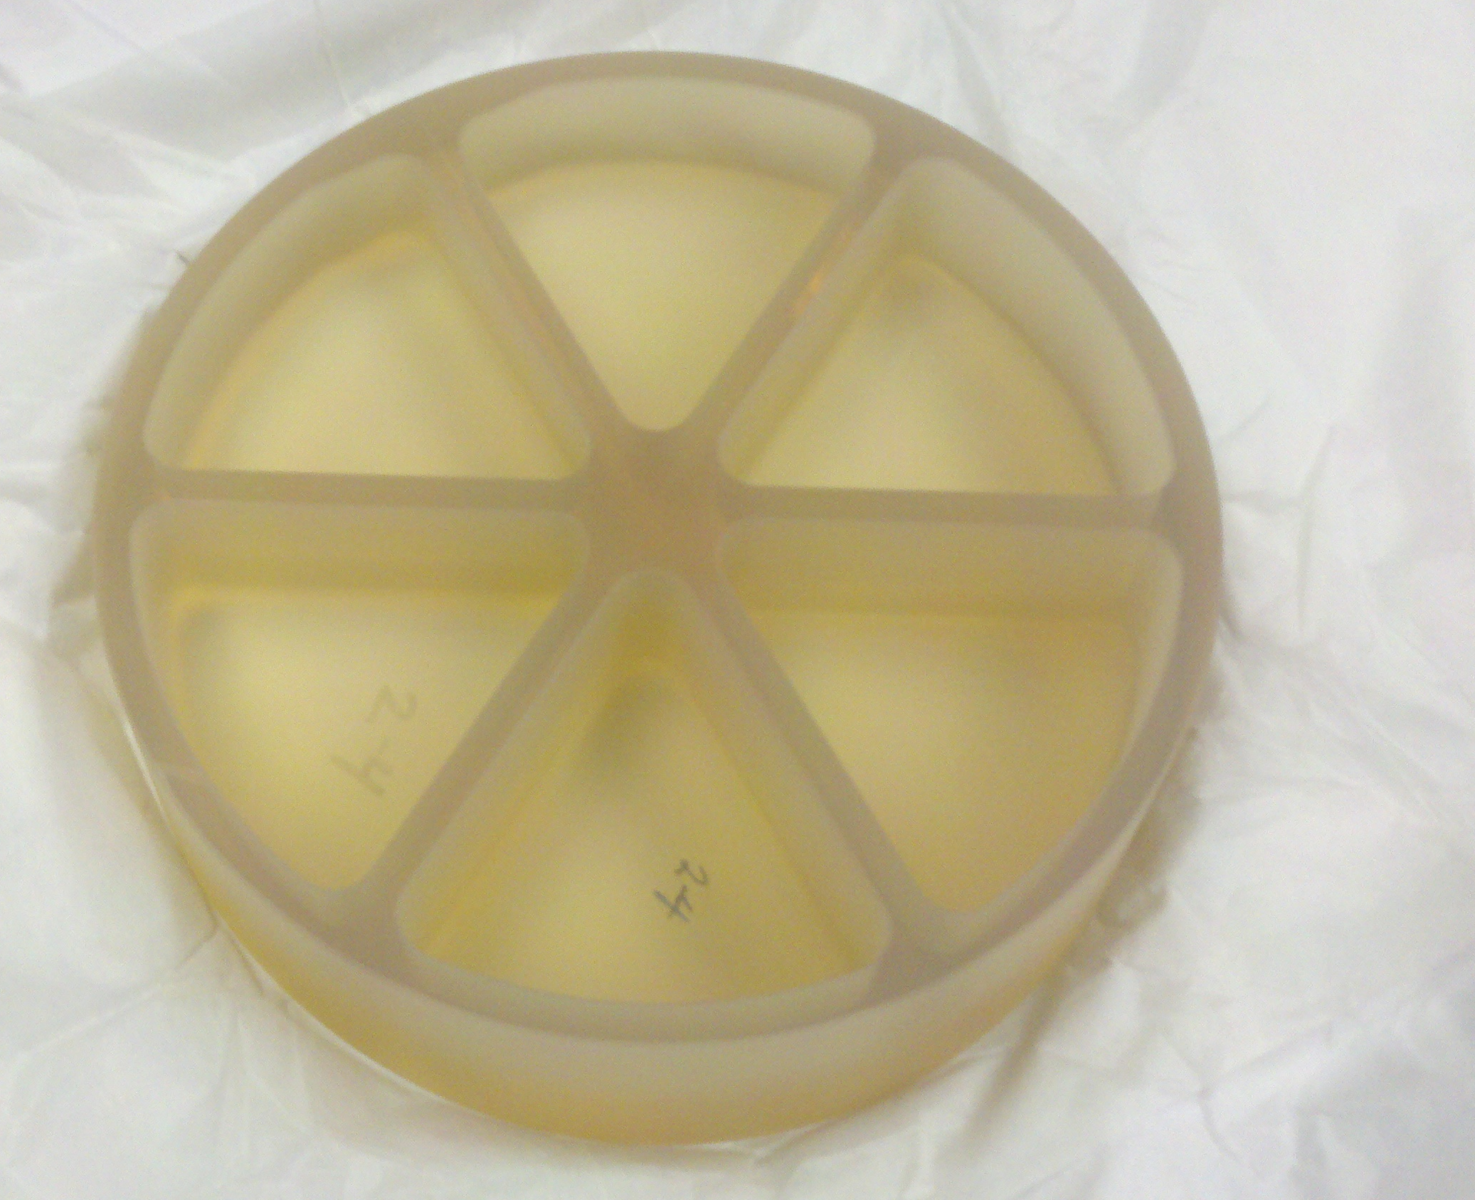
Telescope Mirrors
Mirrors ordered from Precision Asphere, Inc. in Freemont, CA.
Primary mirror specifications
  Clear Aperture: 200 mm
  Off-axis distance: 150mm
  Focal Length: 500mm
  Surface accuracy: 1/10 wave PV at 633nm
  Surface Quality: 40-20
  Fiducials indicating off-axis distance, direction to parent vertex, clocking
Secondary mirror
  Clear Aperture: 18 mm
  Off-axis distance: 13.5mm
  Focal Length: 45mm
  Surface accuracy: 1/10 wave PV at 633nm
  Surface Quality: 40-20
  Fiducials indicating off-axis distance, direction to parent vertex, clocking
Mirrors coated at Rainbow Research Incorporated
  Dielectric coating with measured reflectivity >97% at 355 nm and >98% at 2 µm
  Confirmed laser damage threshold at both 355 nm and at 2 µm assuming spaceflight laser specifications.

Slide 13
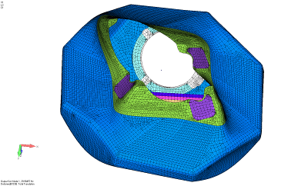
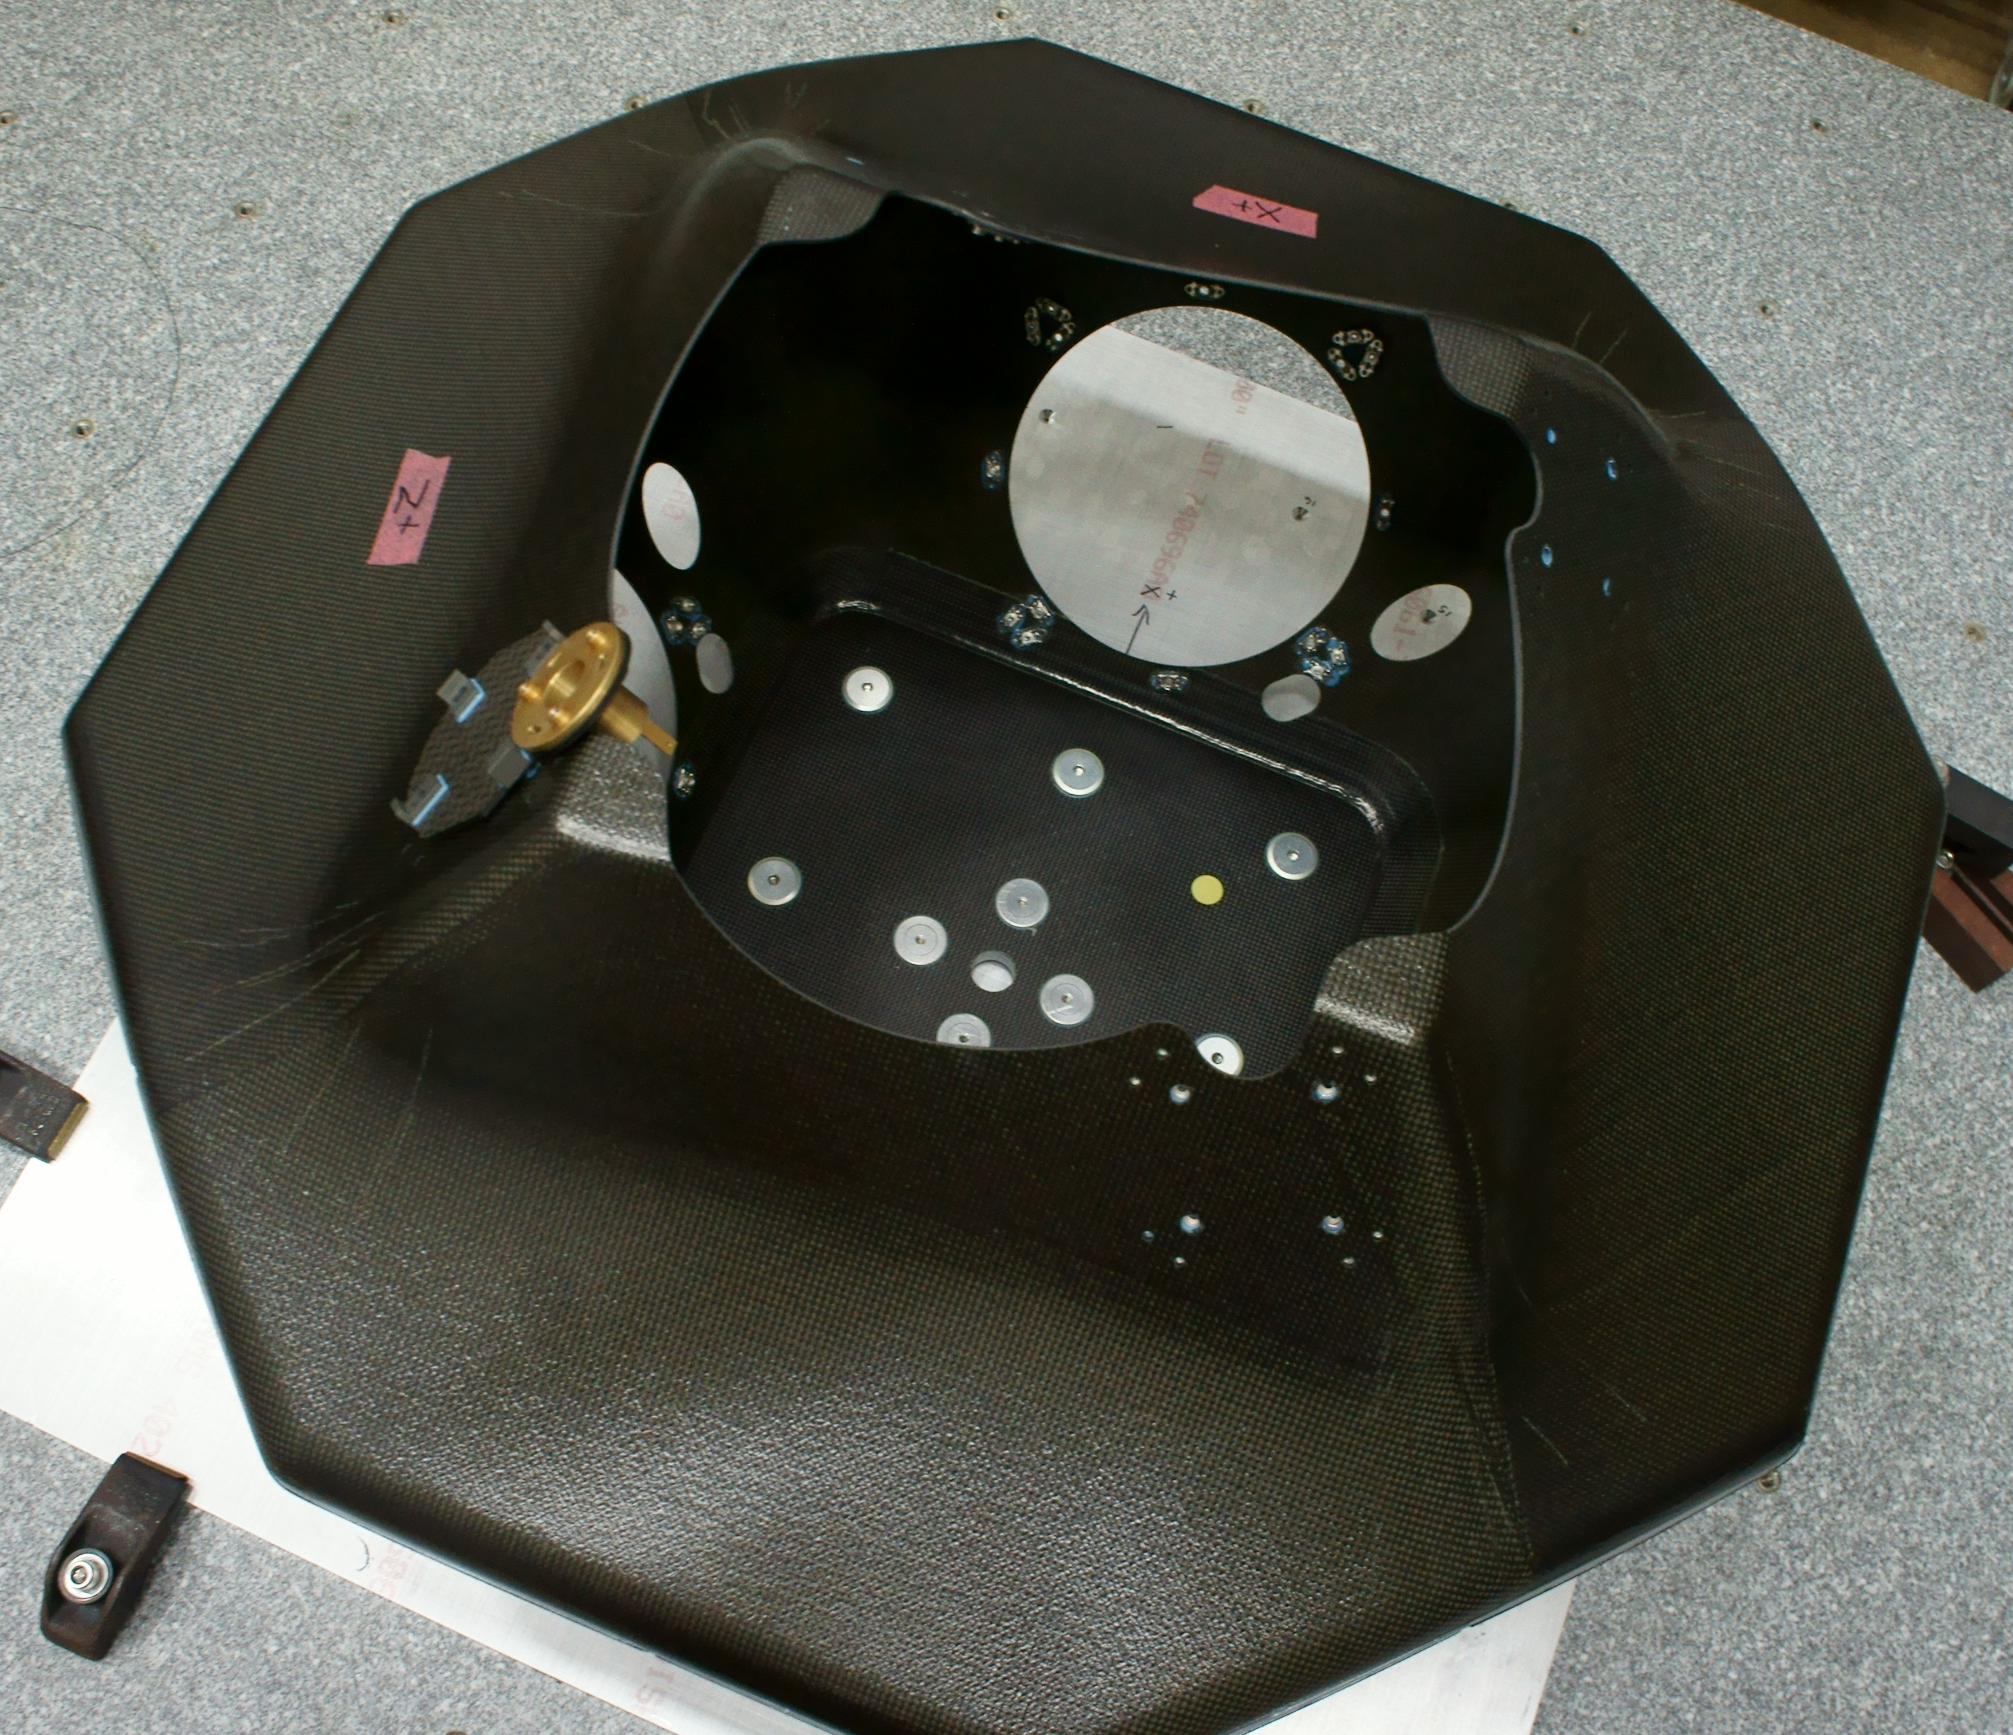
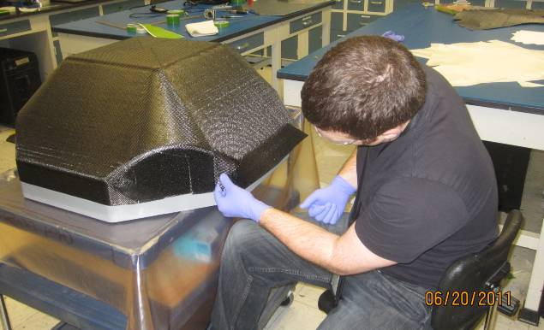
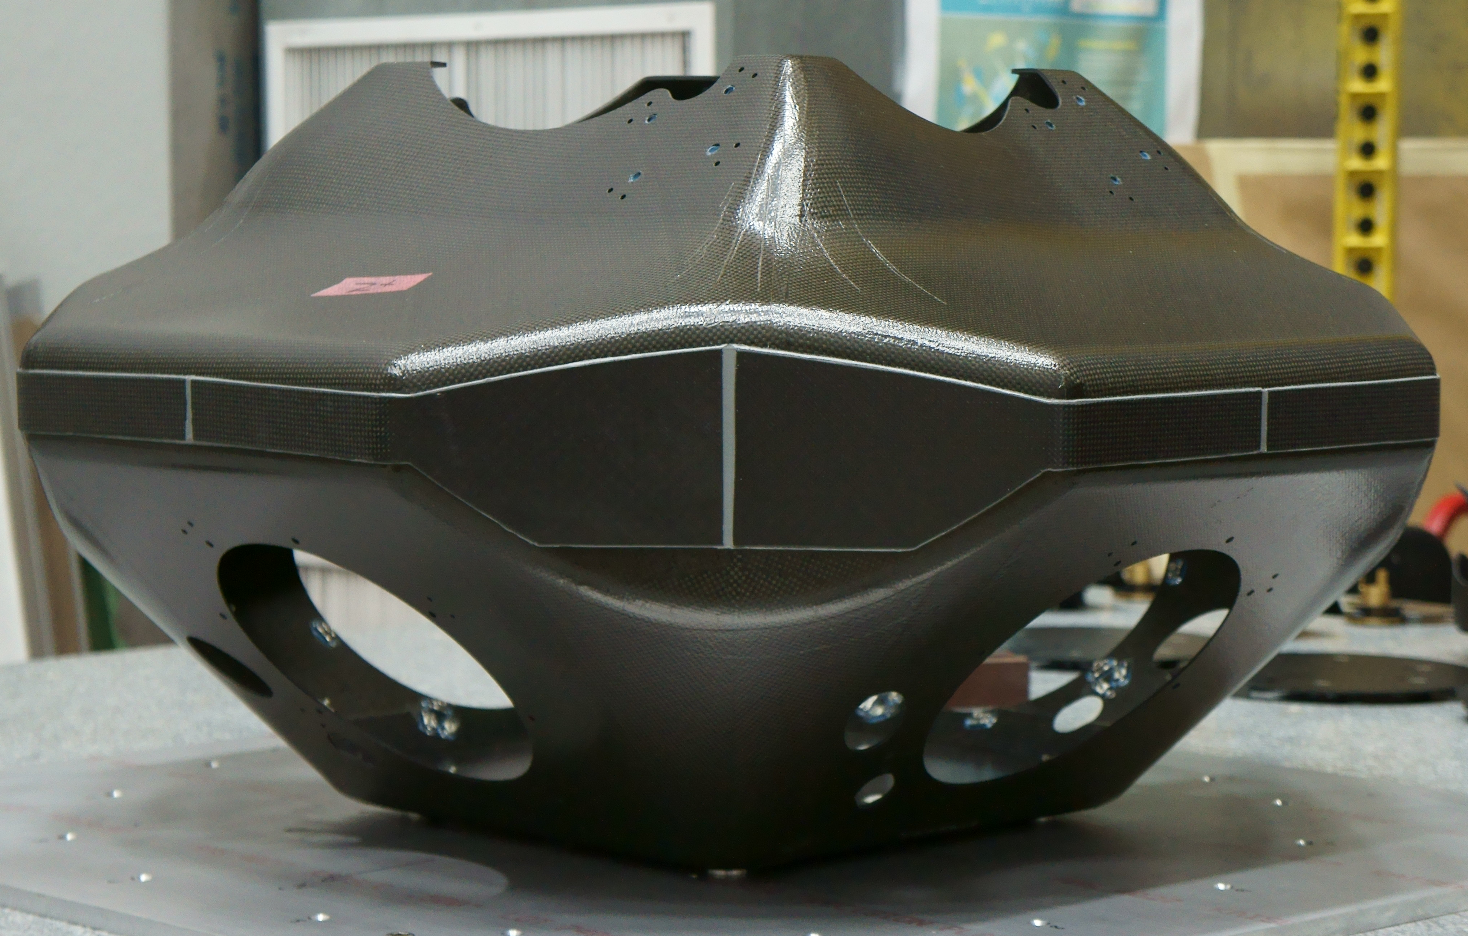
Structure Design
-Working with GSFC Advanced Composite Group to fabricate hardware.
-Received tools and have been fabricating test parts and the actual parts.
This includes – Design, drawings and analysis. (March, 2011)
Tool fabrication (May, 2011)
Structure Build (Dec, 2011)
Parts have multiple layers of composite sheets 8- 12 plys
Added 4 extra sheets
Mode 1 – 40 Hz
Laying up the sheets
Structure Complete
View of Inside
Standard fiber is matrix is MTM45-1 (toughened epoxy). Cured at 180°F followed by a free standing post cure at 250°F.
Shows metal inserts for attaching mounting screws.
Volume less than 33” x 33” x 20”
Weighs 15.2 lbs

Slide 14
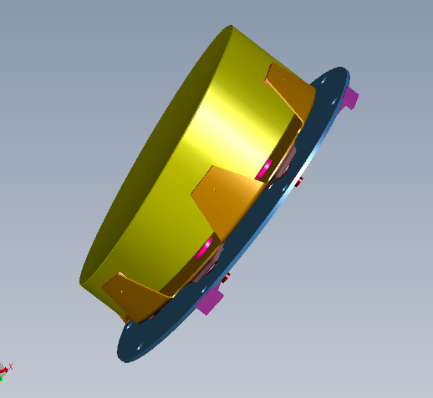
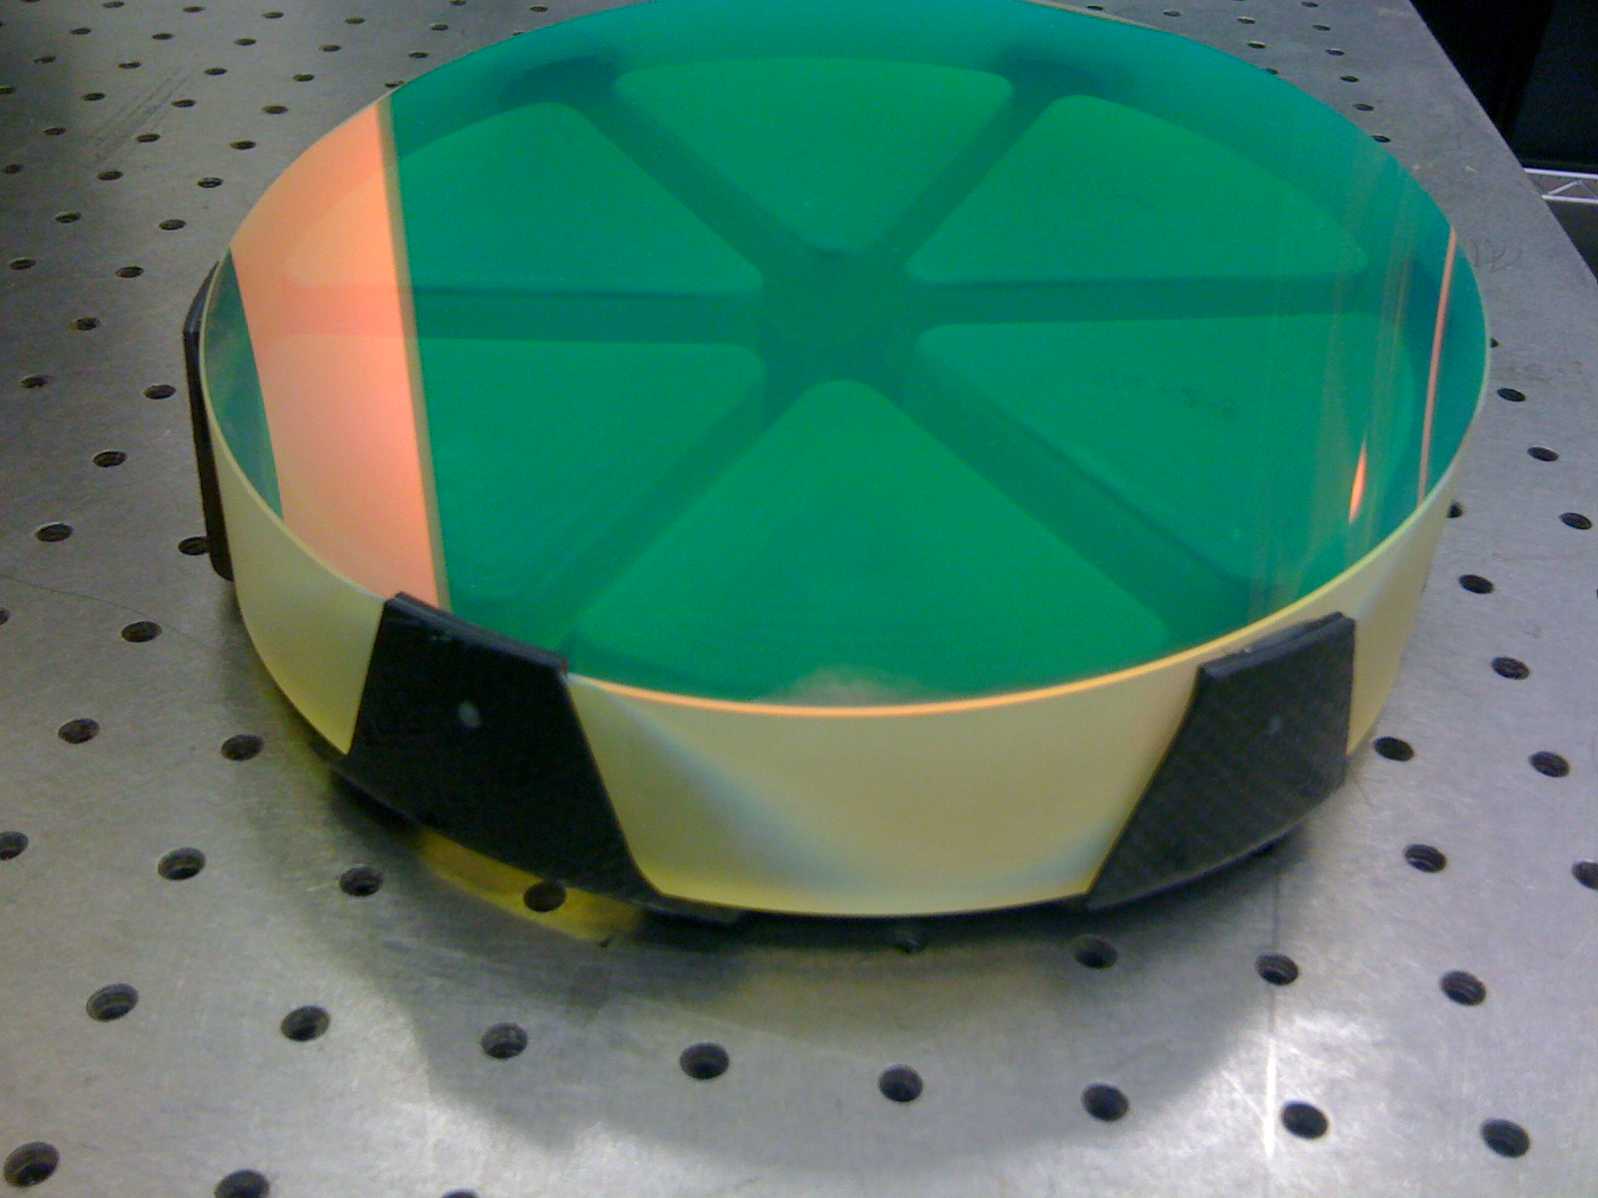
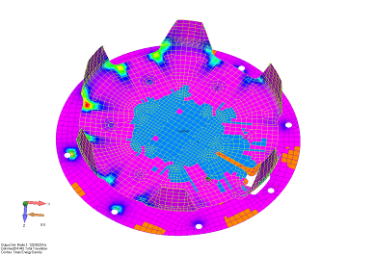
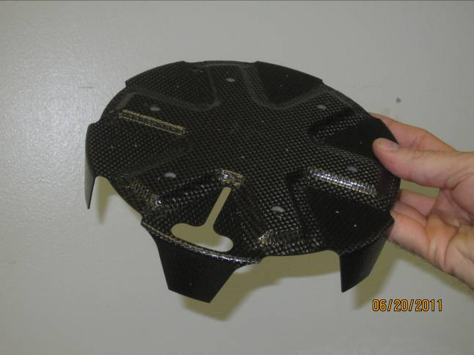
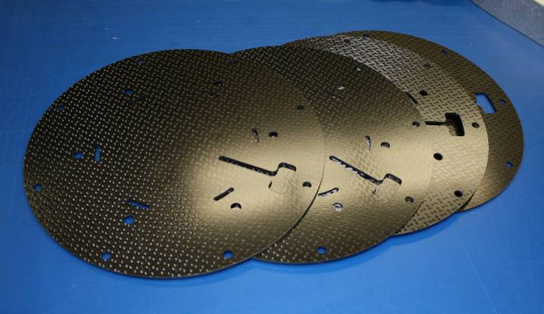
Optic Mounts
Primary Mirror Mount
Composite Flexure
Composite Adjustment Plate
First frequency: 126.6Hz
Composite parts waiting for metal inserts

Slide 15
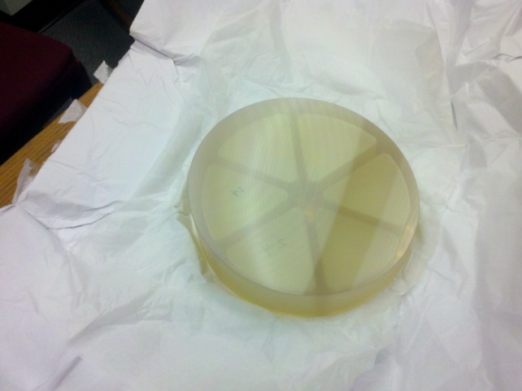
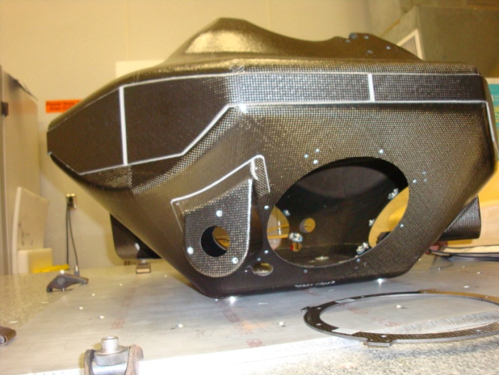
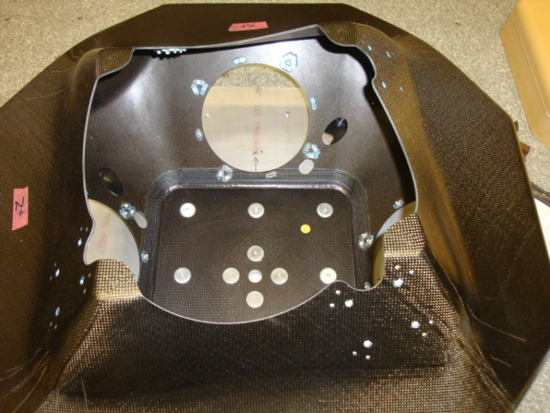
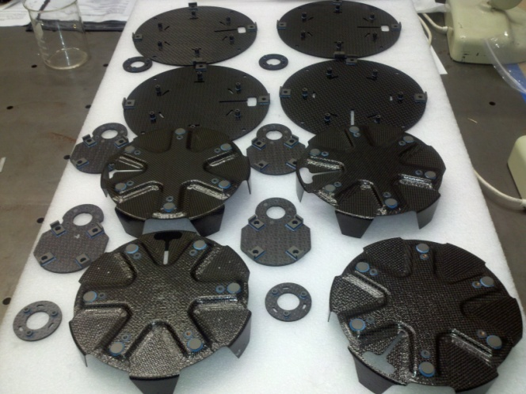
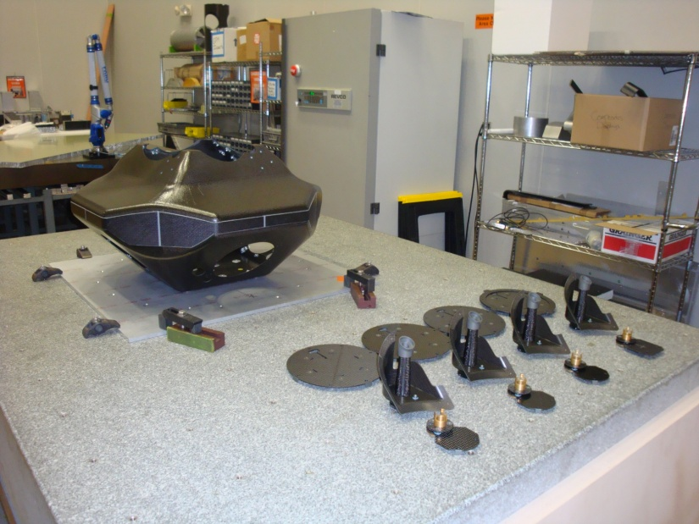
Parts for the assembly of ACT structure

Slide 16
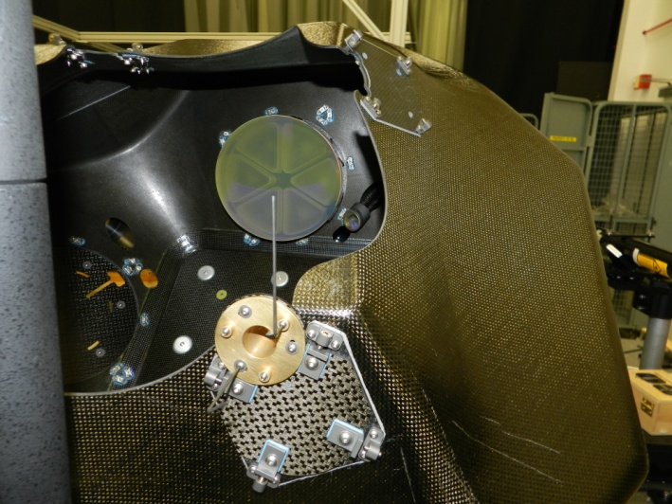
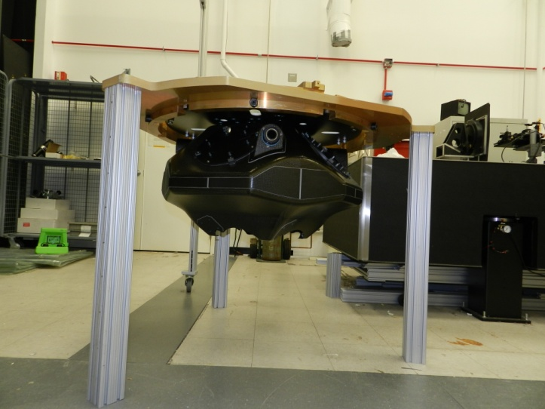
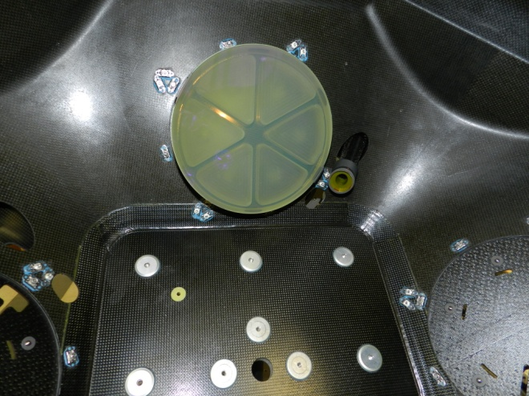
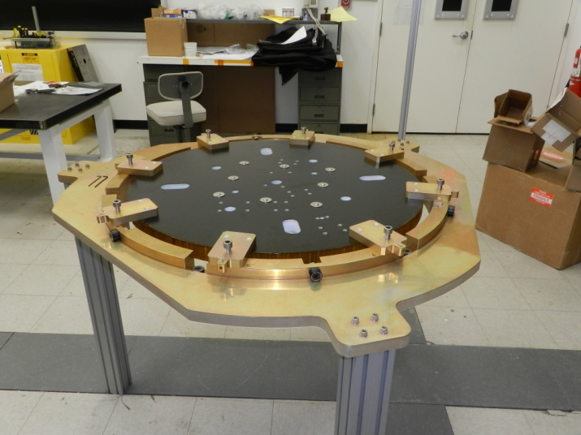
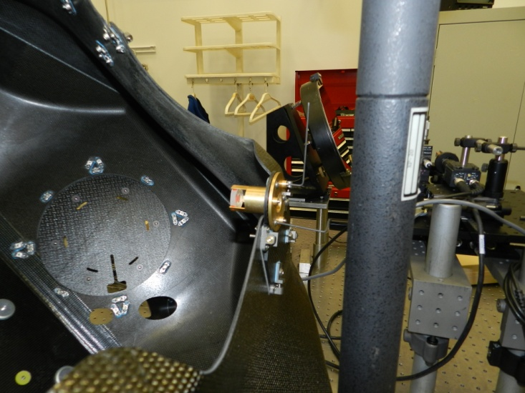
Assembly
Shell weight (no optics) -15.20lbs
Optics bench weight - 8.05lbs
Light-weighted Primary mirrors –
~ 4 lbs each (x4)

Slide 17
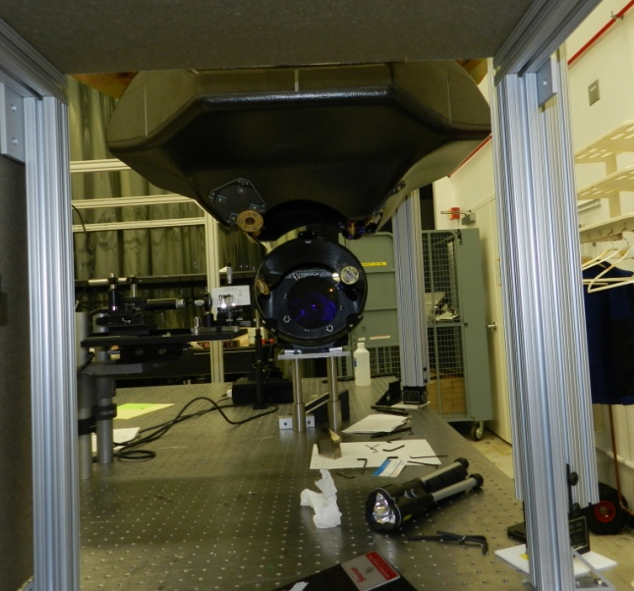
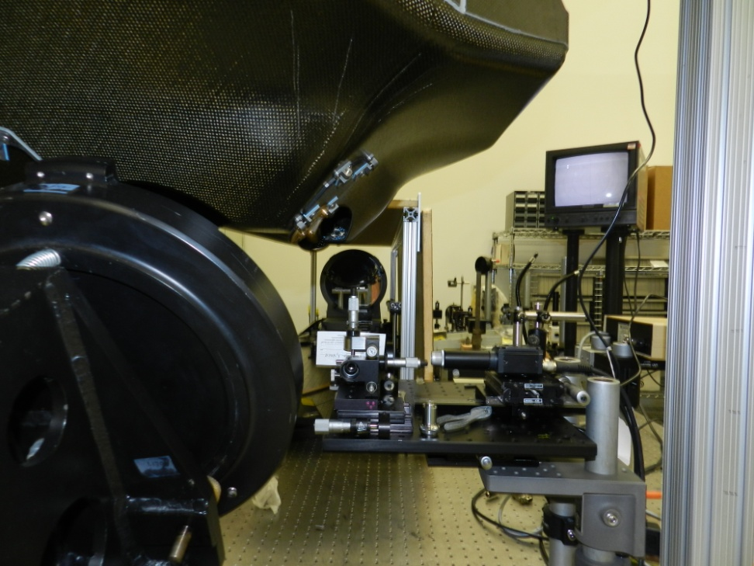
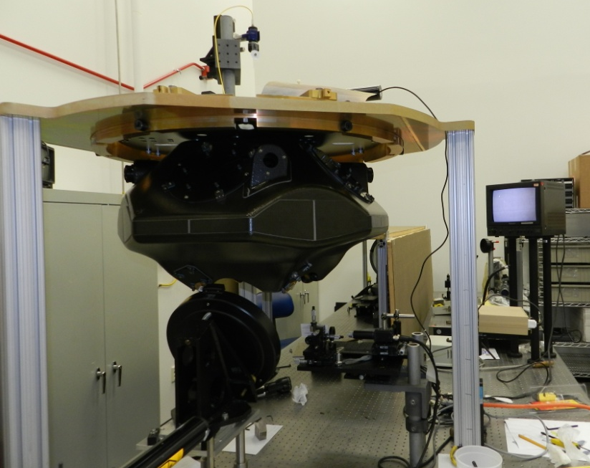
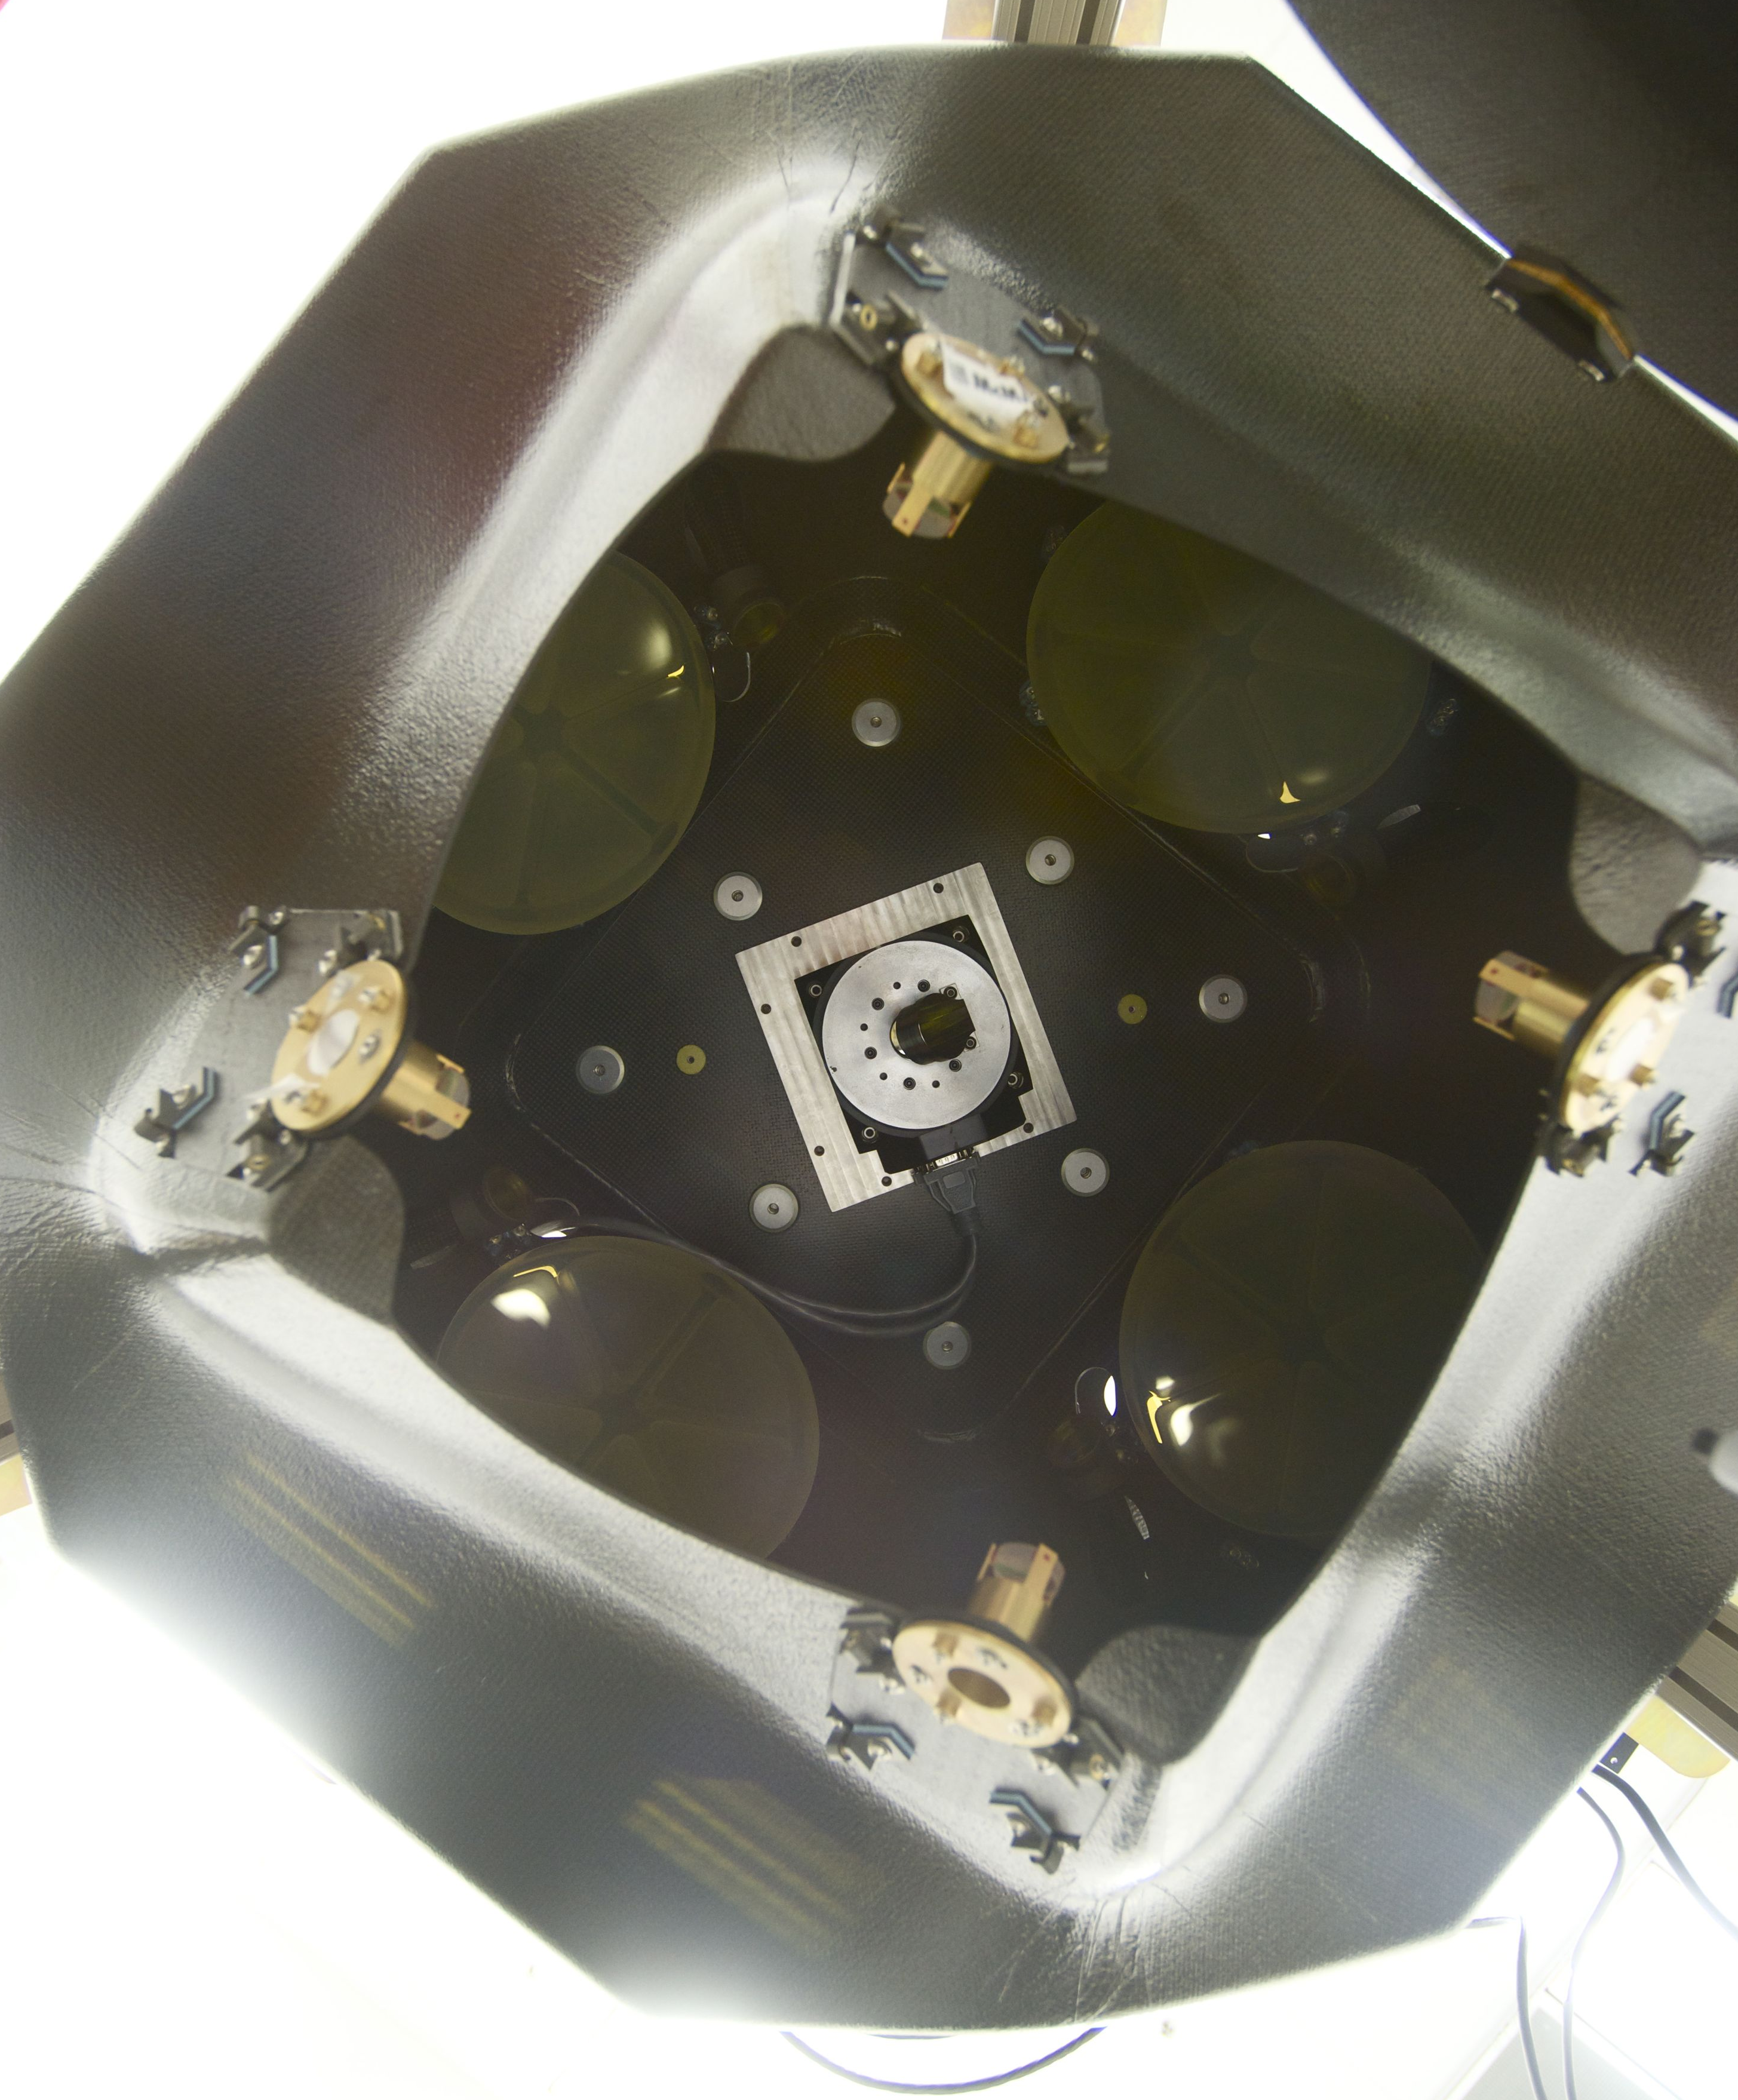
Fine Alignment

Slide 18
Current Status/Plans
Aligned all four telescopes with 632.8 nm source and camera.
Currently switching to 355 nm source and CCD.
Will characterize alignment by measuring spot size, throughput, stability and repeatability for each telescope.
Switch to 2 um source and perform similar measurements.
Move to Beltsville and verify performance at 355 nm with GLOW laser and receiver.
Target completion date: June 2012.

Slide 19
Backup

Slide 20
Optics Bench Layout
To/From 2um laser
¼ waveplate
Beamsplitter
Polarizing beamsplitter
½ waveplate
To/from 355 nm laser
OptoSigma 027-1220
Fiber to 355nm receiver
¼ waveplate

Slide 21
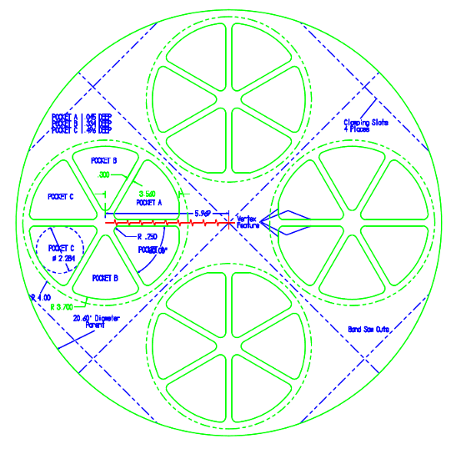
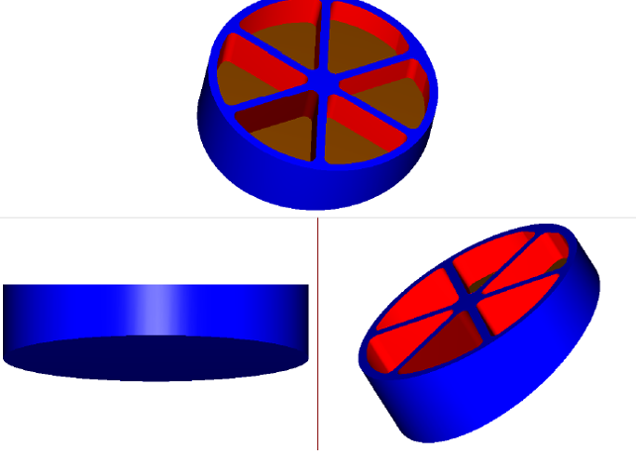
Light Weight Mirrors
Reduced the mass of the 8 in mirror in half ( From 8.5 # To 4.25 #).
Fabrication Process:
Grind & polish solid blank using conventional techniques
Lightweight using machining per drawing
Cut 4 mirrors from single blank
Precision Asphere, Inc
48860 Milmont Drive, Unit 105-C
Fremont, CA 94538

Slide 22
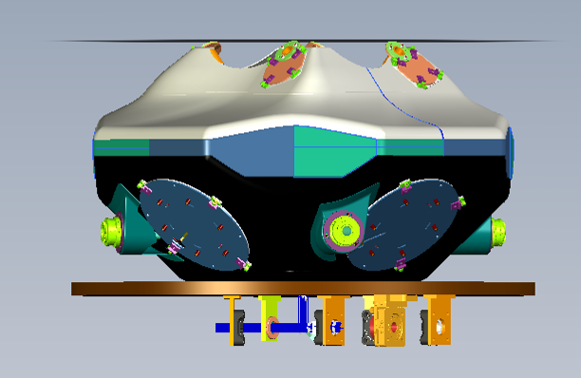
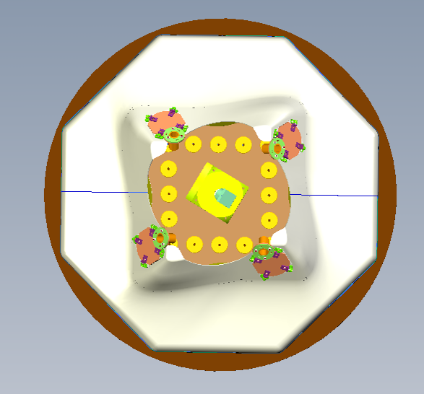
Structure Design Size
19.39
22.39
Unit will be integrated with the 355 and 2 micron lasers
32.41

Slide 23
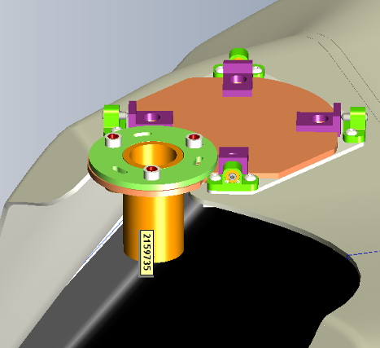
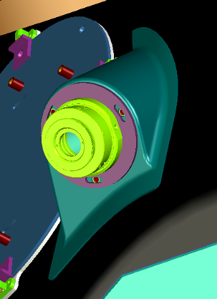
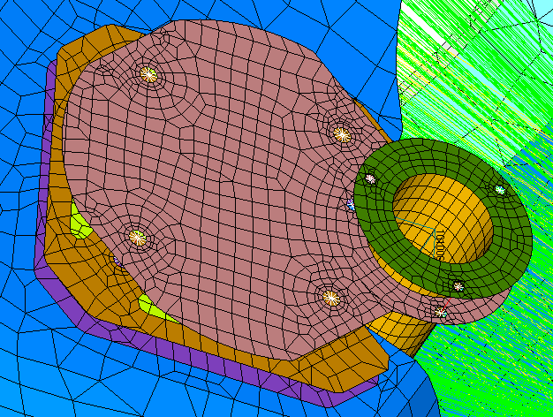
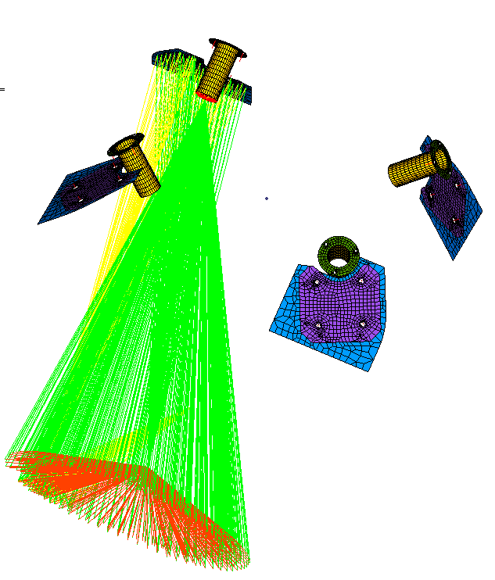
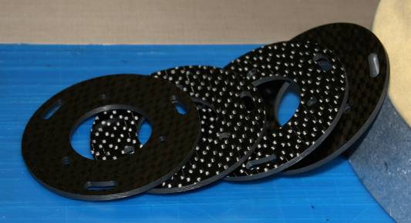
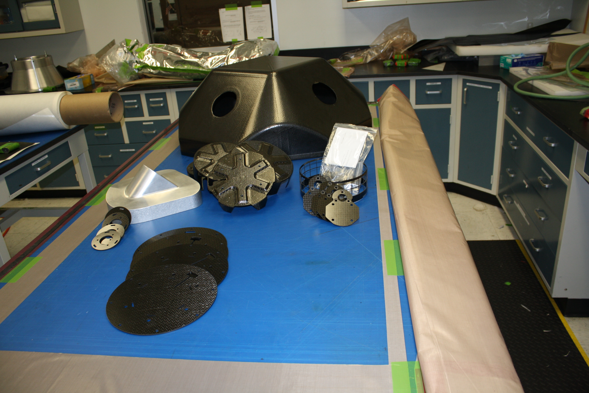
Optic Mounts
Secondary Mount
Fold Mirror Mount

Slide 24
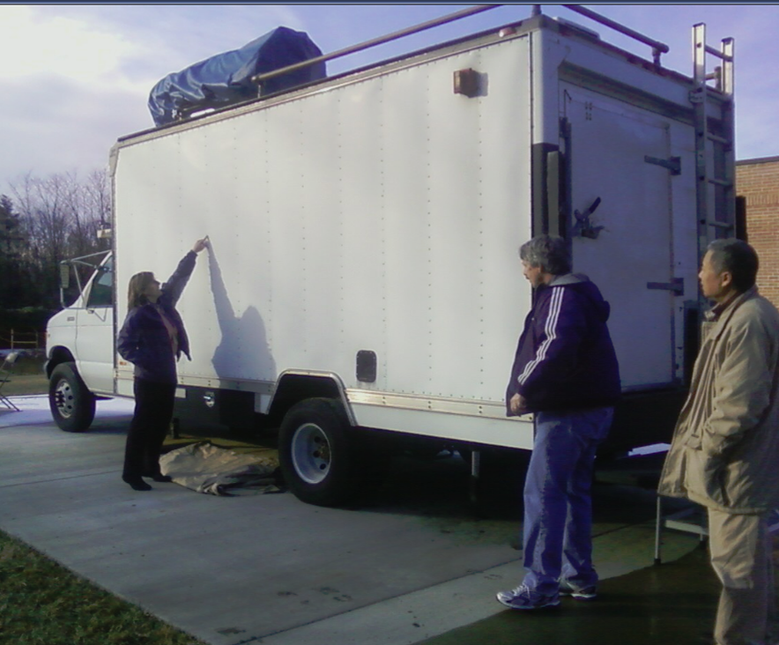
355 nm Test
ACT interface with GLOW
FOV (Clear Truck)
ACT
GSE Structure
GLOW
Cathy showing the spot the window will be added to allow the laser to exit

